Slide 1
Replication Exercise: Bruhn et al. (2010) “Good, Bad, and Ugly Colonial Activities: Do They Matter for Economic Development?”
Harunobu Saijo & Jan Vogler
Duke University

Slide 2
Overview
Research Questions
Background
Theory
Findings
Replication exercise
Extension

Slide 3
Research Questions
What determines long-term economic growth?
What are the underlying causes for the variation in levels of economic development across regions in the New World?
How did colonial activities affect developmental outcomes today?

Slide 4
Background
Engerman and Sokoloff: three types of colonial activities
Determined by factor endowments and affected subsequent economic development
Acemoglu, Johnson, and Robinson: “Reversal of fortunes”
To rule out the possibility that current levels of economic activity simply reflect those of pre-colonial times
Bruhn et al. expands AJR to sub-national levels

Slide 5
Three types of colonial activities
Good: no economies of scale, low pre-colonial population density
ES: These led to small-scale independent economic activity
Bad: economies of scale, rely on exploitation of labor
Ugly: no economies of scale but performed on large scale with forced labor

Slide 6
Theory
How “good”, “bad”, and “ugly” activities could affect outcomes
AJR: Property Rights
ES: Inequality
Glaeser: Human capital of colonists
Analysis seeks to differentiate between different channels/mechanisms

Slide 7
Hypotheses
“Differences in currents levels of development within countries can be explained by differences in colonial activities.”
Areas that had “bad” and “ugly” colonial activities will have lower levels of development today compared to areas that had “good” colonial activities

Slide 8
Findings
Main findings: c.p., areas with “Good” activities have higher level of log PPP GDP per capita than locations that experienced “Ugly” or “Bad” activities
Places with “Bad” activities did worse than places with “Ugly” activities
Only “Bad” activities significant when poverty rate is used as the DV
The estimated effect of pre-colonial population density is significant and strongly negative

Slide 9
Reversal of Fortunes
Are the “Bad” or “Ugly” activities correlated with pre-colonial development?
Diff in diff design
Findings: no difference in development
Pre-colonial: High population density areas more developed previously
Post-colonial: High population density areas less developed
Areas without colonial activities saw positive relationship between population density and development; the opposite is true for areas where there were such activities

Slide 10
Unpacking Mechanisms
AJR: Property rights through representative institutions
Proxy: malapportionment in the legislature measured with log seats per voter in lower house
Result: confirms hypothesis : bad/ugly activities and population density negatively correlated with “Log Seats in lower house per voter”
ES: Inequality
Proxy: current income inequality (log Gini index)
Result: no difference between activity areas
Glaeser: Human capital of colonists
Proxy: log literacy rate and log schools per child
“None of the colonial variables show any statistically significant correlation with our human capital variables.”

Slide 11
Replication Exercise Slides

Slide 12
Contradictions in the text
“In areas with a large native population, activities with economies of scale were typically performed in large-scale operations with forced labor. We call these colonial activities, which relied primarily on the native population as an exploitable resource, “ugly” colonial activities.” (p. 433)
“More specifically, areas that had bad colonial activities (those with economies of scale, relying heavily on the exploitation of labor) or ugly colonial activities (those without economies of scale practiced in areas with high precolonial population density, relying on forced labor)…” (p. 437)

Slide 13
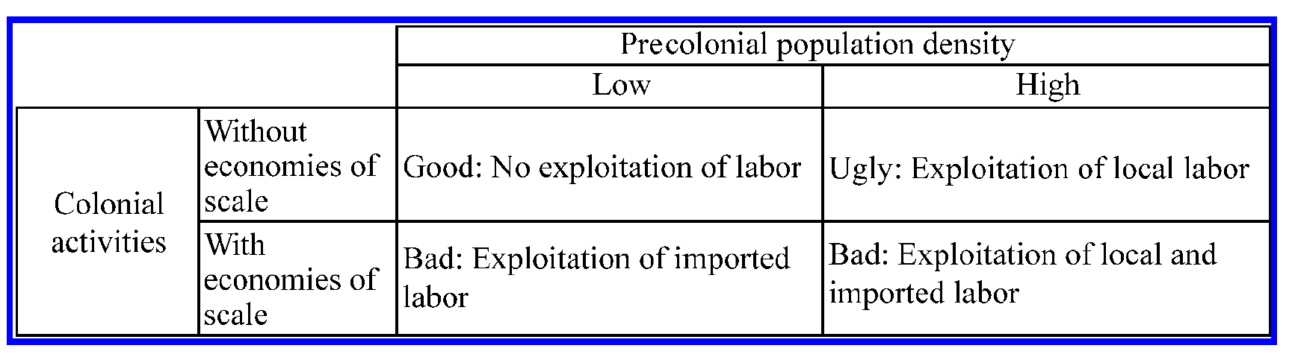
The solution?

Slide 14
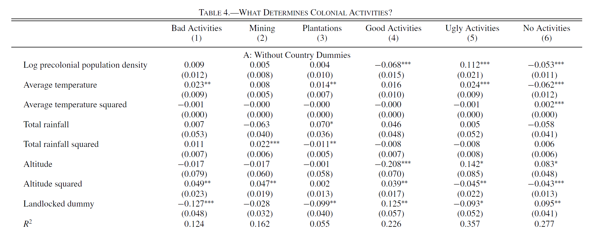
Table 4 replication

Slide 15
egen country_n=group(country)
for num 1/17: g cdX=0 if country_n~=.
for num 1/17: replace cdX=1 if country_n==X
foreach z in ebad enone mining plantations egood2_50 ugly_50{
reg `z' lpopd temp* rain* alti* landlocked, cluster(lpopd)
estimates store `z'_wofe
test temp_ temp2 rainf rain2 alti alti2
reg `z' lpopd temp* rain* alti* landlocked cd2-cd17, cluster(lpopd)
estimates store `z'_wfe
test temp_ temp2 rainf rain2 alti alti2
}

Slide 16
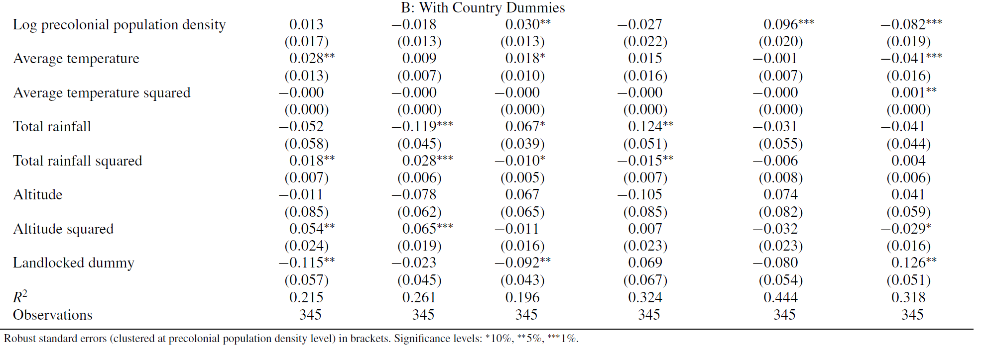
Table 4 part 2 replication

Slide 17
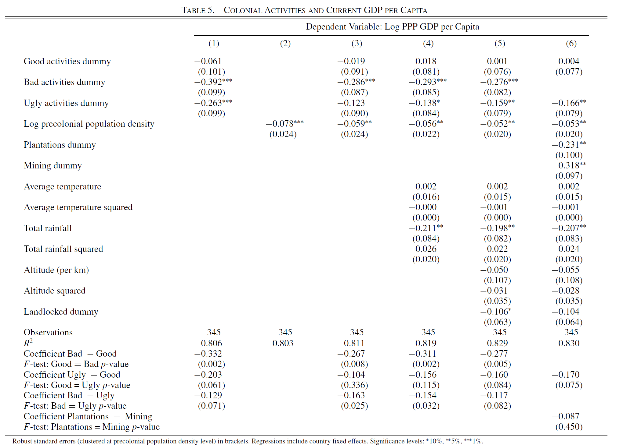
Table 5 replication

Slide 18
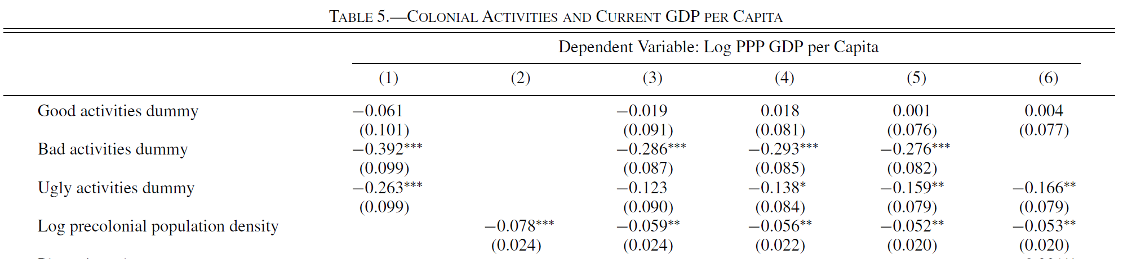
Table 5 replication

Slide 19
Table 5 replication
areg lyppp egood2_50 ebad ugly_50, a(country) cluster(lpopd)
estimates store reg1
test egood2_50=ebad
test egood2_50=ugly_50
test ebad=ugly_50
areg lyppp lpopd, a(country) cluster(lpopd)
estimates store reg2
areg lyppp egood2_50 ebad ugly_50 lpopd , a(country) cluster(lpopd)
estimates store reg3
test egood2_50=ebad
test egood2_50=ugly_50
test ebad=ugly_50

Slide 20
Extension
Could colonial reversal be taking place through conflict as well? Use recent conflict centers as DV.
Are outliers driving the outcomes? Re-run regression with subsets of the data.

Slide 21
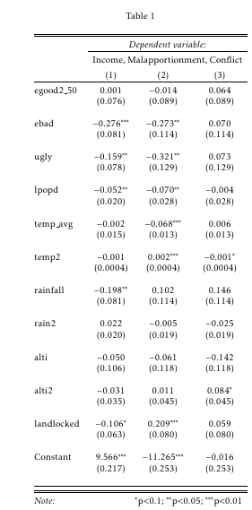
Extension 1: Do “colonial activities” cause variation in outcomes via modern conflict?
Column 1: Log GDP/Capita (10.1)
Column 2: Log Seats in lower house per voter (10.5)
Column 3: Original conflict variable: Number of conflicts recorded in the subnational unit as recorded in the ConflictSite dataset (1989-2008)

Slide 22
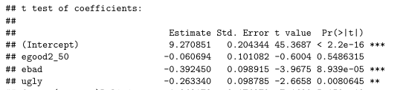
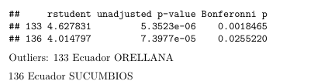
Extension 2: Are outliers driving results? Looking at basic model (Table 5 Model 1)
Lowest Bonferonni P-values: two regions from Ecuador
Table 5 Model 1 readout:

Slide 23
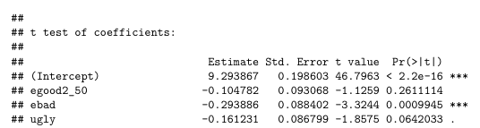
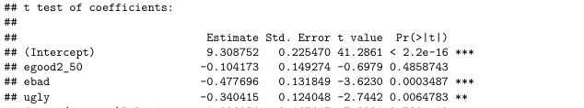
Running 5.1 (limited sample)
Without Ecuador:
Without the US/Canada:

